Slide 1


Best Selling Phones Analysis
Insights Through
SQL Queries

Slide 2

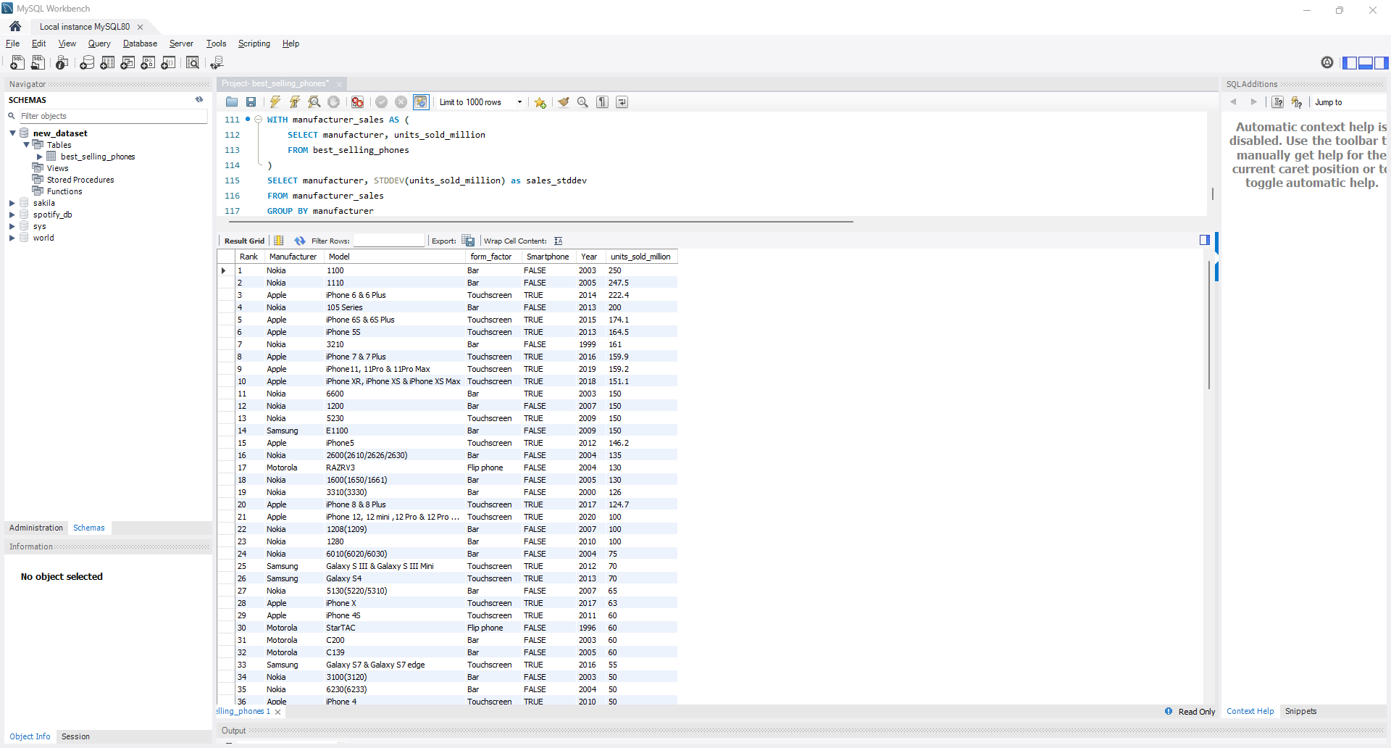
Lets have a look over the data:
SELECT * FROM
best_selling_phones;

Slide 3
Performing Analysis using some SQL Queries
SQL stands for Structured Query Language. It is a standardized programming language specifically designed for managing and manipulating relational databases. SQL is used to perform various operations on the data stored in a database, such as querying data, inserting new data, updating existing data, and deleting data.

Slide 4
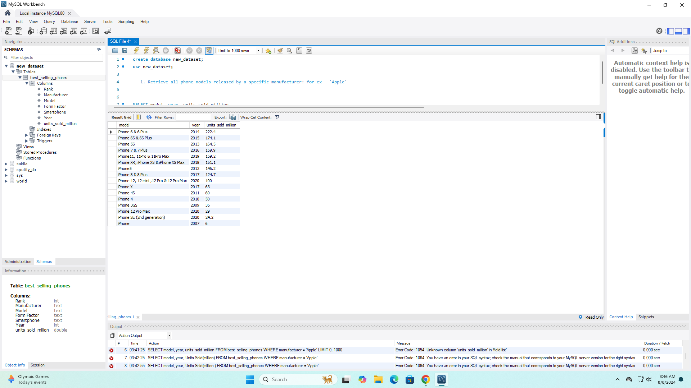
1. Retrieve all phone models released by a specific manufacturer: for ex - 'Apple'
SELECT model, year, units_sold_million
FROM best_selling_phones WHERE
manufacturer = 'Apple';

Slide 5
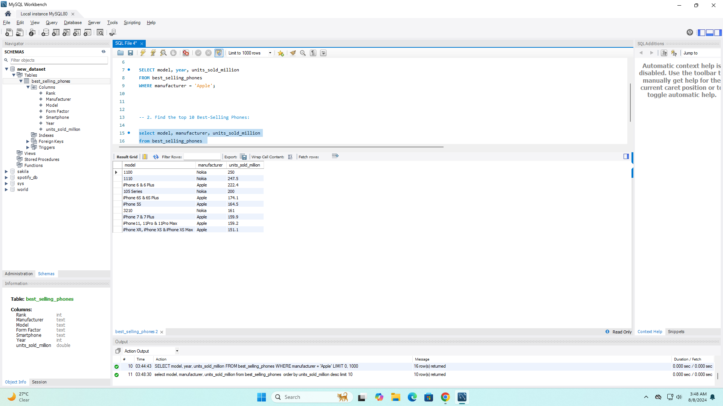
2. Find the top 10 Best-Selling Phones:
SELECT model, manufacturer, units_sold_million
FROM best_selling_phones
ORDER BY units_sold_million desc LIMIT 10;

Slide 6
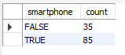
3. Count the number of Smartphones vs. Non-Smartphones:
SELECT smartphone,
COUNT(*) as count
FROM
best_selling_phones
GROUP BY smartphone;

Slide 7
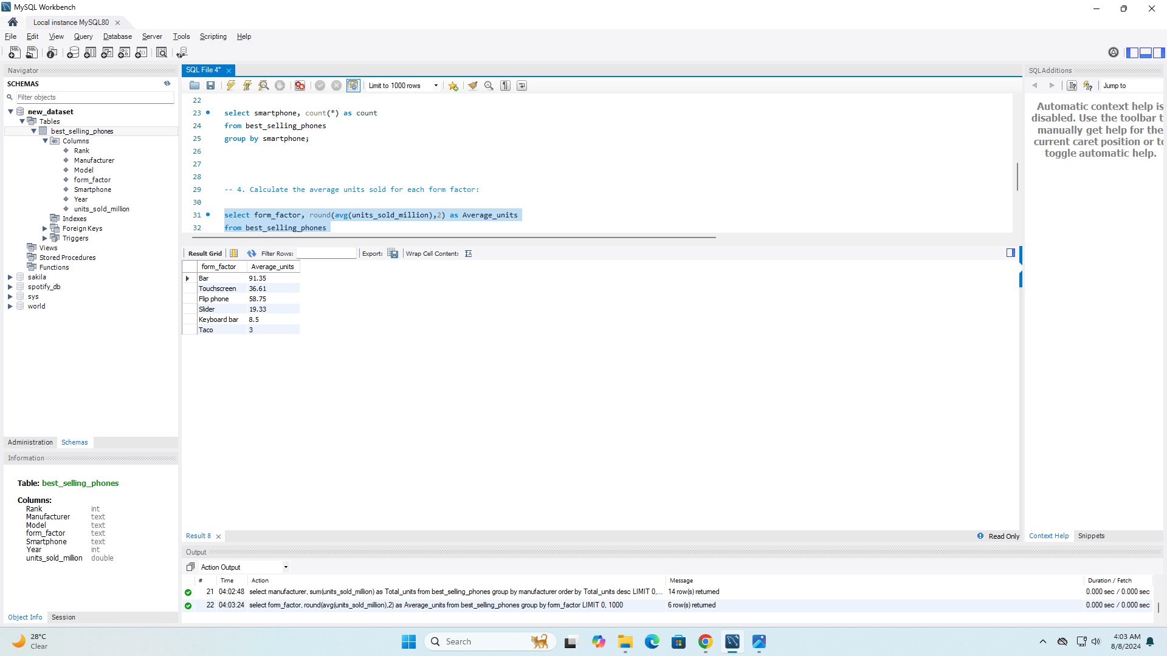
4. Calculate the average units sold for each form factor:
SELECT form_factor, ROUND(AVG(units_sold_million),2) AS Average_units
FROM best_selling_phones GROUP BY form_factor;

Slide 8
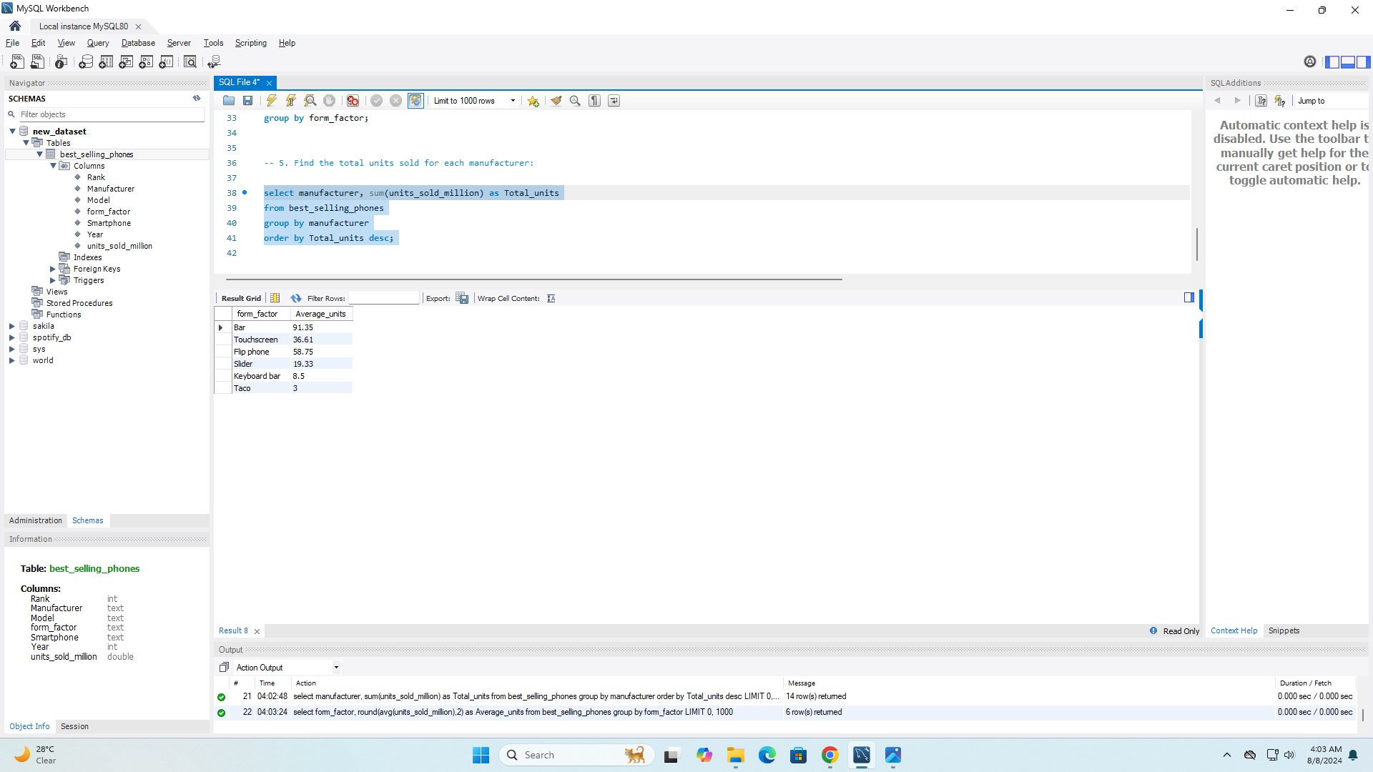
5. Find the total units sold for each manufacturer:
SELECT manufacturer, SUM(units_sold_million) AS Total_units FROM best_selling_phones GROUP BY manufacturer ORDER BY Total_units DESC;

Slide 9
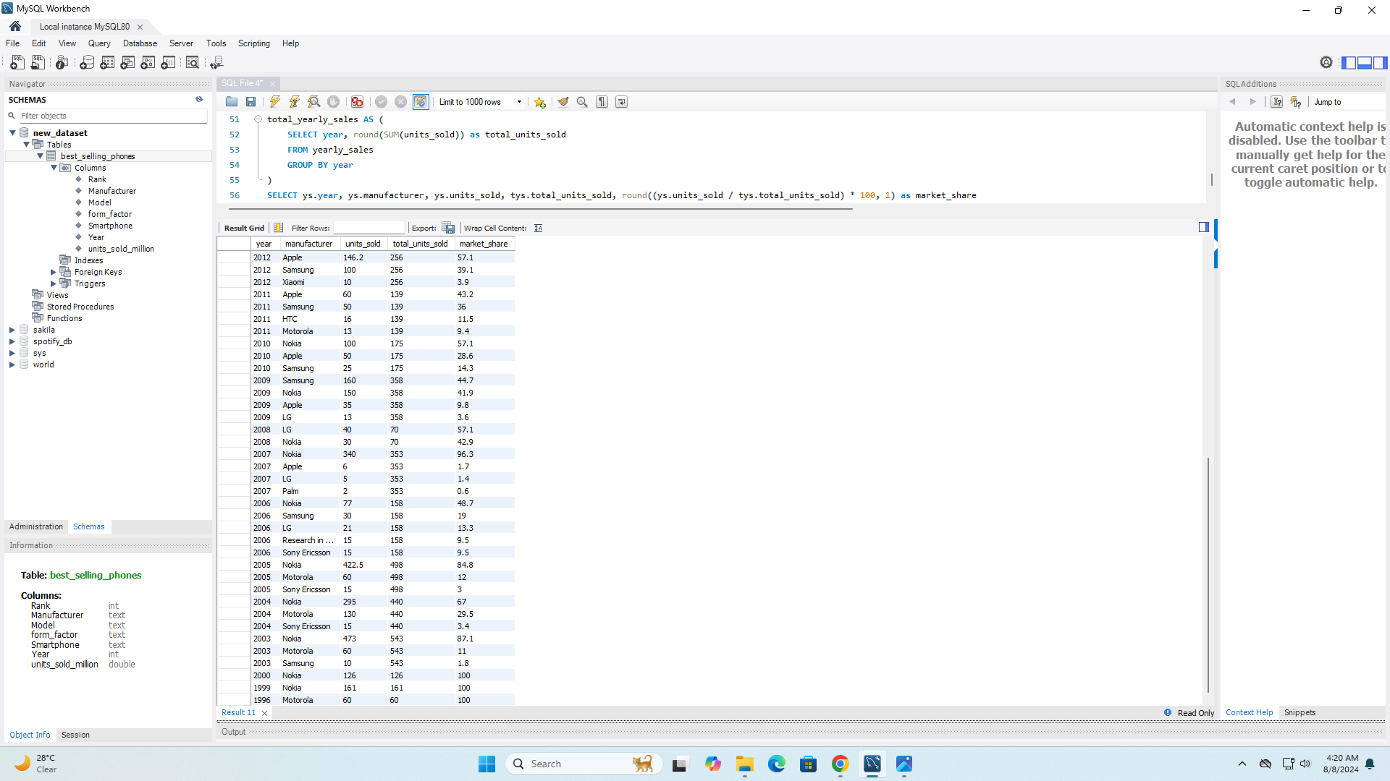
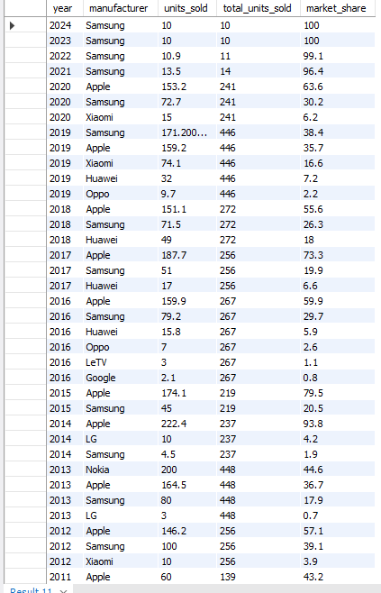
6. Analyze the Market_share of each manufacturer over time:
WITH yearly_sales AS (SELECT year, manufacturer, SUM(units_sold_million) as units_sold FROM best_selling_phones GROUP BY year, manufacturer),total_yearly_sales AS (SELECT year, round(SUM(units_sold)) as total_units_sold FROM yearly_sales GROUP BY year)
SELECT ys.year, ys.manufacturer, ys.units_sold, tys.total_units_sold, round((ys.units_sold / tys.total_units_sold) * 100, 1) as market_share FROM yearly_sales ys JOIN total_yearly_sales tys ON ys.year = tys.yearORDER BY ys.year, market_share DESC;

Slide 10
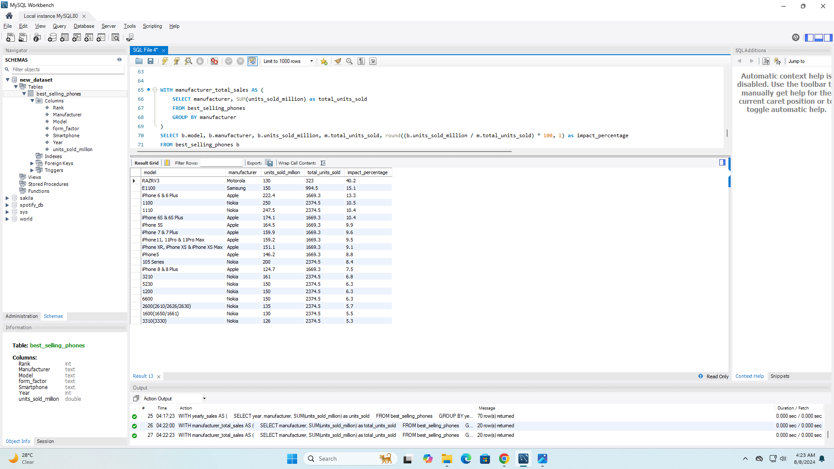
7. Identify models that sold more than 100 Million units and their impact on the manufacturer's overall sales:
WITH manufacturer_total_sales AS (SELECT manufacturer, SUM(units_sold_million) as total_units_sold FROM best_selling_phones GROUP BY manufacturer)
SELECT b.model, b.manufacturer, b.units_sold_million, m.total_units_sold, round((b.units_sold_million / m.total_units_sold) * 100, 1) as impact_percentage FROM best_selling_phones b JOIN manufacturer_total_sales m ON b.manufacturer = m.manufacturer WHERE b.units_sold_million > 100 ORDER BY impact_percentage DESC;

Slide 11
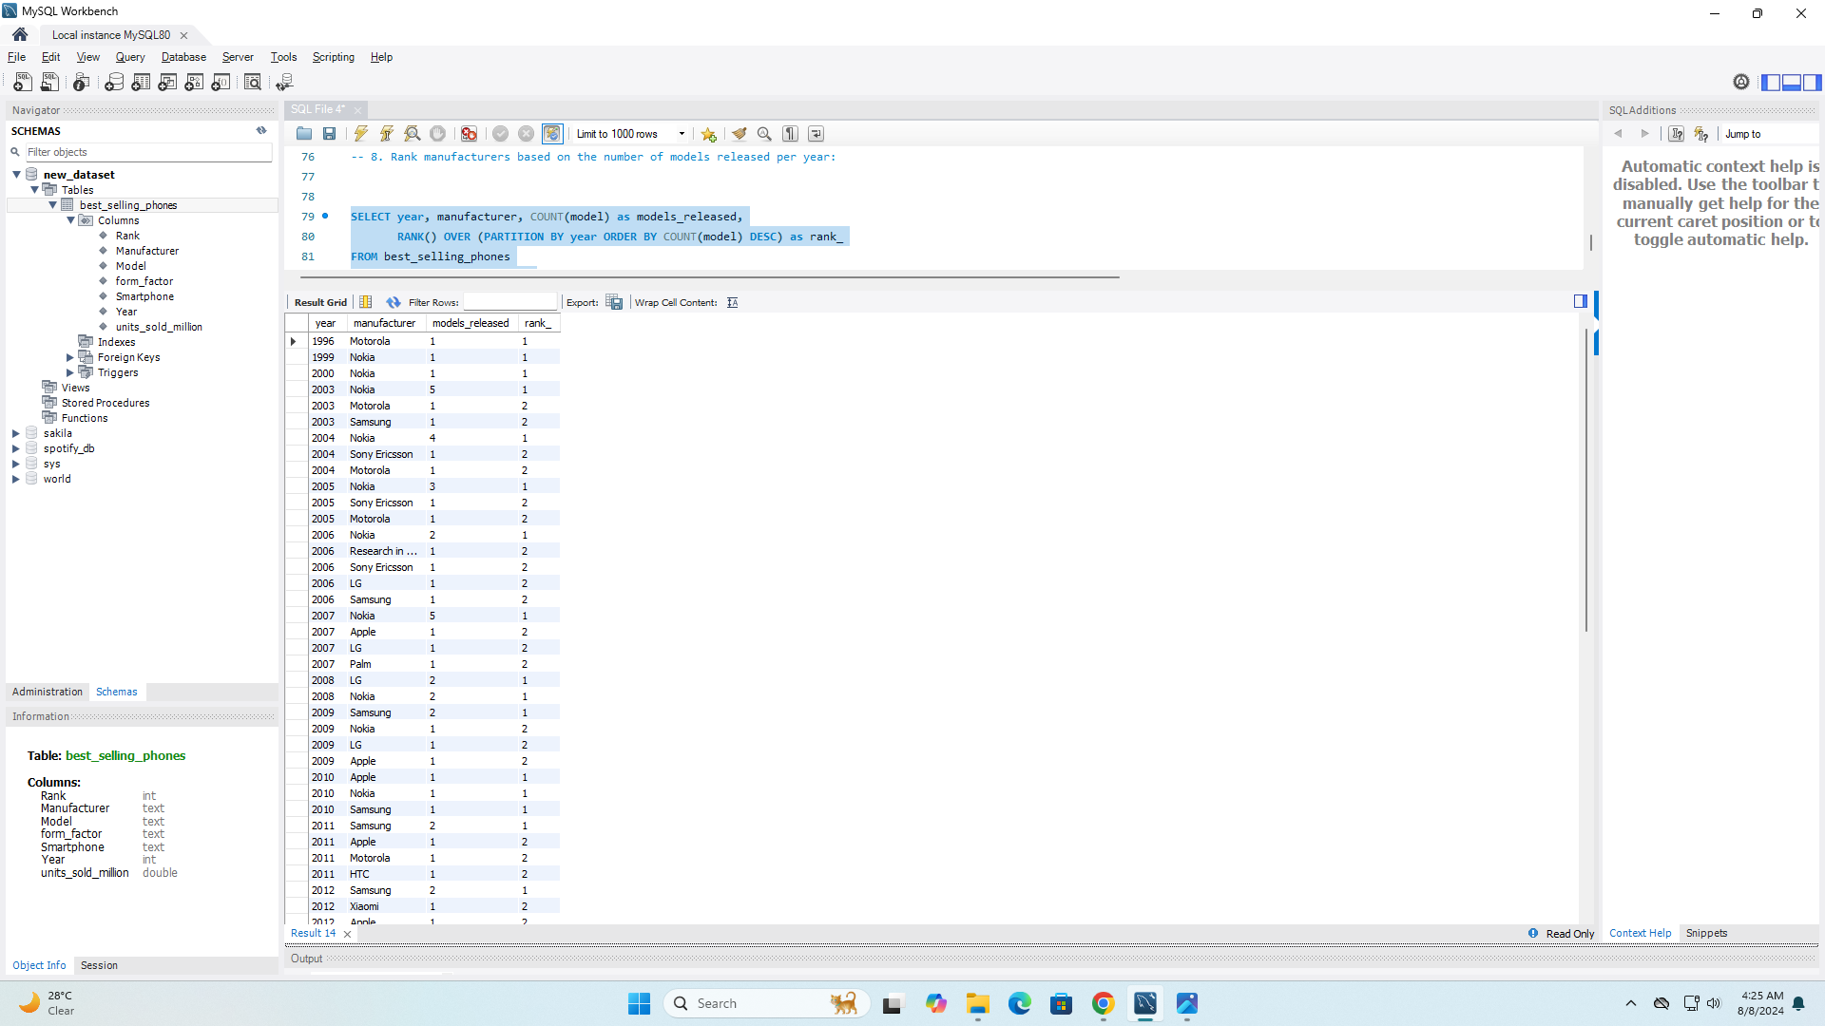

8. Rank manufacturers based on the number of models released per year:
SELECT year, manufacturer, COUNT(model) as models_released, RANK() OVER (PARTITION BY year ORDER BY COUNT(model) DESC) as rank_ FROM best_selling_phones GROUP BY year, manufacturer ORDER BY year, rank_;

Slide 12
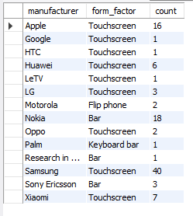
9. Find the most popular form_factor for each manufacturer over the years:
SELECT manufacturer, form_factor, count FROM (SELECT manufacturer, form_factor, COUNT(*) as count, ROW_NUMBER() OVER (PARTITION BY manufacturer ORDER BY COUNT(*) DESC) as rn FROM best_selling_phones GROUP BY manufacturer, form_factor) AS ranked_phones WHERE rn = 1 ORDER BY manufacturer;

Slide 13
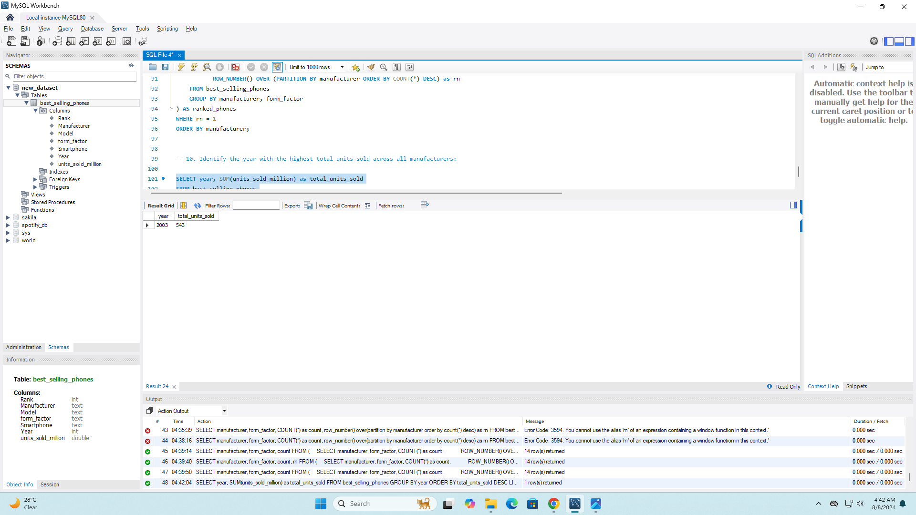
10. Identify the year with the highest total units sold across all manufacturers:
SELECT year, SUM(units_sold_million) as total_units_sold FROM best_selling_phones GROUP BY year ORDER BY total_units_sold DESC LIMIT 1;

Slide 14
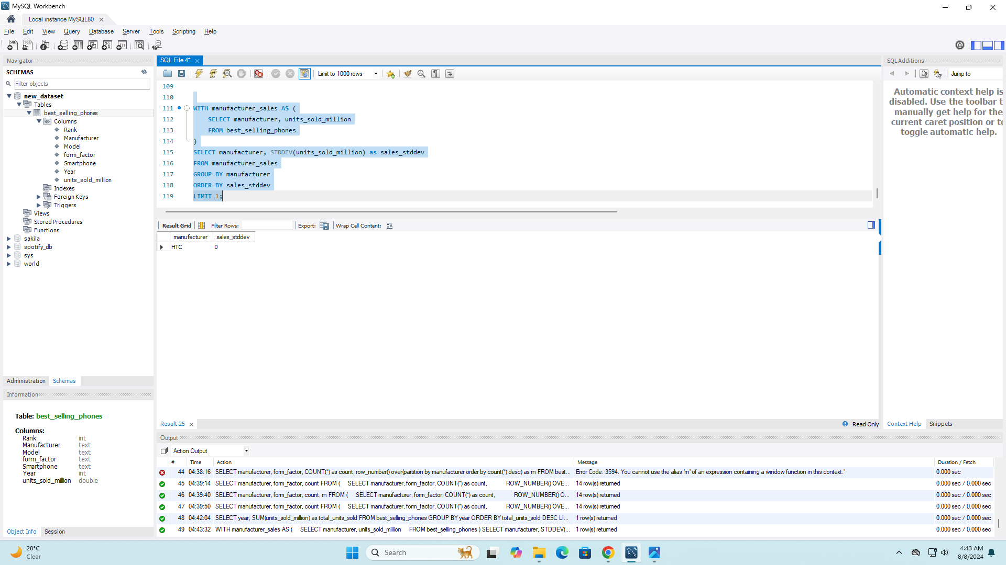
11. Find the manufacturer with the most consistent sales performance (Lowest Standard Deviation in units sold):
WITH manufacturer_sales AS (SELECT manufacturer, units_sold_million FROM best_selling_phones) SELECT manufacturer, STDDEV(units_sold_million) as sales_stddev FROM manufacturer_sales GROUP BY manufacturer ORDER BY sales_stddev LIMIT 1;

Slide 15


